Slide 1
THE ENDOCRINE SYSTEM
JOE

Slide 2
INTRODUCTION
Consists of endocrine glands that secret specific chemicals called hormones into the bloodstream
The system works closely with the nervous system in regulating body processes
A hormone is a chemical messenger secreted by an endocrine gland

Slide 3
A hormone is formed in one organ or gland and carried in the blood to another organ (target organ or tissue)
When a hormone arrives at its target cell, it binds to a specific area, the receptor
The receptors for water-soluble hormones are situated on the cell membrane and those for lipid-soluble hormones are inside the cell

Slide 4
Differences between the endocrine and nervous systems
Endocrine system | Nervous system
Communicates by means of hormones | Communicates by means of electrical impulses and neurotransmitters
Releases neurotransmitters at synapses | Releases hormones into bloodstream
Reacts quickly to stimuli, usually within 1 to 10 msec | Reacts more slowly to stimuli, often taking seconds to days
Stops quickly when stimulus stops | May continue responding long after stimulus stops

Slide 5
Classes and composition of hormones
catecholamines; are derived from simple amino acids(C,H,N $ NH2 group)
Polypeptides; long chains of amino acids
Glycoproteins; large proteins combined with carbohydrates
Steroids; lipids
Fatty acid derivatives; long hydrocarbon acid chains

Slide 6
Classification by receptor site
Hormones are also divided into two groups depending on the site of its receptors; whether intracellular or extracellular
Group 1 hormones: these are hormones which bind to intracellular receptors. They are lipophilic
Group 2 hormones: these are hormones that bind to surface receptors. They are hydrophilic

Slide 7
Feedback mechanism
This is a system that helps to regulate the amounts of the hormones in the body
A hormone is released in response to a specific stimulus
A. Negative feedback: in this mechanism, an increase in the end product leads to a decrease in the starting product. The hormone reverses the action of the stimulus e.g ADH production

Slide 8
B. The positive feedback: this mechanism, an increase in the stimulus increases the response. An increase in the end product leads to the increase in the starting product. Eg oxytocin production

Slide 9
The endocrine glands
1 pituitary gland
• 1 thyroid gland
• 4 parathyroid glands
• 2 adrenal (suprarenal) glands
• the pancreatic islets (islets of Langerhans)
• 1 pineal gland or body
• 1 thymus gland
• 2 ovaries in the female
• 2 testes in the male

Slide 10
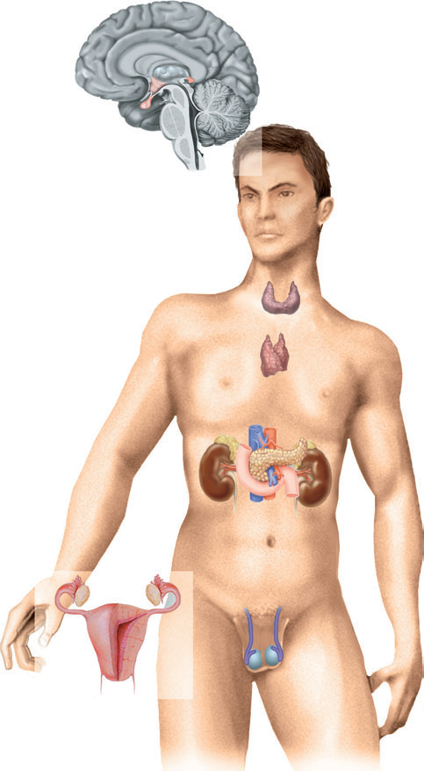
hypothalamus
Pineal gland
Pituitary
gland
Thyroid gland
Thymus
Adrenal gland
pancreas
ovary
testes

Slide 11
The pituitary gland and the hypothalamus
The pituitary gland (hypophysis) and the hypothalamus act as a unit, regulating the activity of most of the other endocrine glands
The pituitary gland lies in the hypophyseal fossa of the sphenoid bone below the hypothalamus, to which it is attached by a stalk (infindibulum)

Slide 12
..
The pituitary gland is a pea-shaped gland.
Divided into three segments/lobes.
The posterior pituitary/ neurohypophysis
The adenohypophysis
The intermediate lobe.

Slide 13
The hypothalamus has the role to regulate the release of hormones by the pituitary gland.
It produces releasing and inhibiting hormone which have an effect by stimulating release of a hormone or the inhibition of the release of a hormone

Slide 14
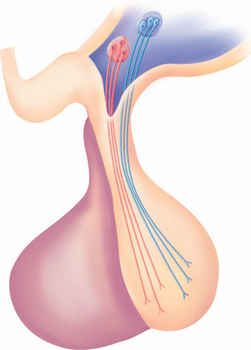

Slide 15
The anterior pituitary
Some of the hormones secreted by the anterior lobe (adenohypophysis) stimulate or inhibit secretion by other endocrine glands while others have a direct effect on target tissues
The whole system is controlled by a negative feedback mechanism.

Slide 16
Hormones of the adenohypophysis
a. Growth hormone (GH)
This is the most abundant hormone synthesised.
It stimulates protein synthesis and growth and division of most body cells especially those in the bones and skeletal muscle.
-Its release is stimulated by growth hormone releasing hormone (GHRH) and suppressed by growth hormone release inhibiting hormone (GHRIH/ somatostatin) both of which are secreted by the hypothalamus

Slide 17
b. Thyroid stimulating hormone
Stimulates release of thyroid hormones from the thyroid gland.
its release is stimulated by Thyroid Releasing Hormone from the hypothalamus
The thyroid hormones are T3 (triiodothyroxine) and T4 (thyroxine) which help regulate the calcium levels

Slide 18
c. Adrenocorticotropic hormone
Stimulates the release of cortisol from the adrenal cortex which helps in glucogenesis
Its release is controlled by corticotrophin releasing hormone.

Slide 19
d. Prolactin
Promotes the development of the mammary glands and the production of milk.
Its release is stimulated by prolactin releasing hormone and inhibited by prolactin inhibiting hormone/dopamine

Slide 20
e. The gonadotrophins
1. Follicle stimulating hormone
Stimulates gametogenesis in both males and females from the testes and the ovaries.
2. Luteinising hormone
Stimulates production of estrogen and progesterone by the corpus luteum in females and production of testosterone in males

Slide 21
Both the LH and FSH are involved in the female menstrual cycle.
The release of the gonadotrophins is controlled by the gonadotrophin releasing hormone

Slide 22
The neurohypophysis
Produces two principal hormones
Oxytocin
Targets the uterus and mammary glands
Stimulates the ejection of milk and contraction of the uterus
Controlled by positive feedback

Slide 23
B. Vasopressin/ Antidiuretic Hormone
Targets kidney tubules
It promotes reabsorption of water in the kidney tubules reducing urine output

Slide 24
summary
-The endocrine system consists of glands that produce hormones
-The hormones are released into the blood
-Hormones from the glands have target tissues and organs with which they evoke a response.
-At the target organs/tissues there are specific receptors for the hormones

Slide 25
- The classes of the hormones according to composition: catecholamine, polypeptide, glycoprotein, steroid and fatty acid derivatives
-Classification by site of receptor: group 1 hormones and group 2 hormones
-Regulation of the amounts of hormones is by a feedback mechanism which can be negative or positive feedback

Slide 26
- The pituitary gland is considered the master gland as it produces most of the hormones and involved in production of others
-The pituitary gland is divided into the posterior, the anterior pituitary and intermediate lobe
-The hypothalamus secretes releasing and inhibiting hormones thus controlling pituitary gland.

Slide 27
- The adenohypophysis secretes growth hormone, thyroid stimulating hormone, adrenocorticotrophic hormone, prolactin and the gonadotrophins
-The neurohypophysis secretes only two hormones: oxytocin and vasopresin/ADH

Slide 28
questions
1. Chemical substances secreted by the endocrine glands are called?
2. What medium are the hormones transported in
3. Which gland is named the master gland
4. State two differences between the nerous and the endocrine system
5. State the classification of hormones by composition
6. Give the three divisions of the hypophysis
7. The only hormones produced by the neurohypophysis are..
8. State the other name of growth hormone release inhibiting hormone

Slide 29
.
GRACIAS
THANK YOU
MERCI BEAUCOUP

